Slide 1
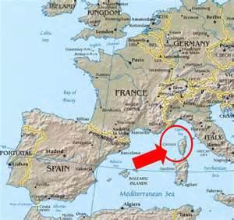
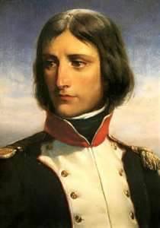
French Revolution: The Age of Napoleon: Part 3
Early Life
• Napoleon Bonaparte —born in Corsica, attends military school, joins army

Slide 2
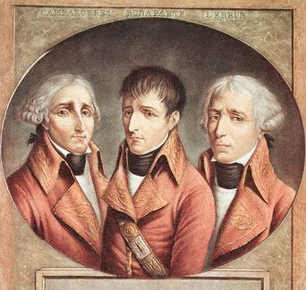
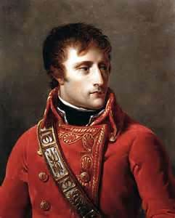
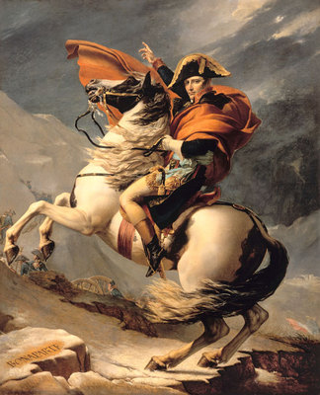
Napoleon Rises to Power
20 year old lieutenant when Revolution begins
Wins many battles, becomes General
1798 – Used press to make himself look like a hero
Had spies everywhere
1799 – moves from General to Political Leader – overthrows the Directory
The Consulate = He sets up a 3 man governing board – of which he was one.
He took title of First Consul
1802 – makes himself Consul for Life
1804 – Crowns himself Emperor

Slide 3
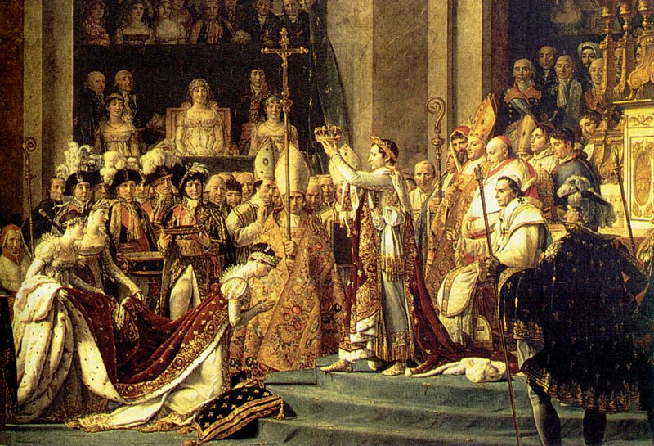
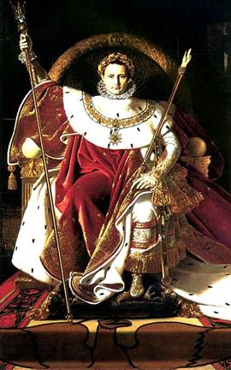
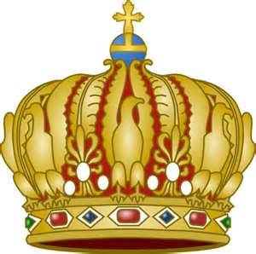
He invited Pope to his coronation, during ceremony he took crown from Pope and put it on his own head!!!!!
Showed that he owed his throne to no one but himself.
Napoleon held absolute power

Slide 4
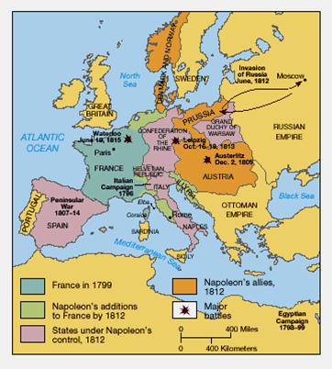
From 1804 – 1812 Napoleon used his military skills to build his GRAND EMPIRE. It included the following:
French Empire - France and territory in Italy & Germany Dependent states - Napoleon had forcibly deposed the monarchs and placed his relatives on the thrones - Kingdoms of Italy, Naples, Holland, Spain; Westphalia and the Duchy of Warsaw Allied states - long term allies: Bavaria and Saxony AND defeated enemies forced into alliance: Prussia, Russia, & Austria & more

Slide 5
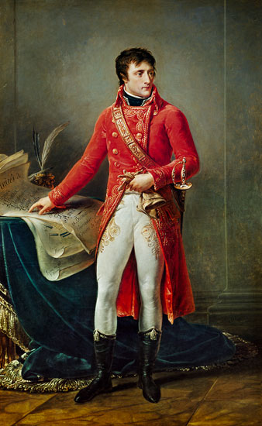
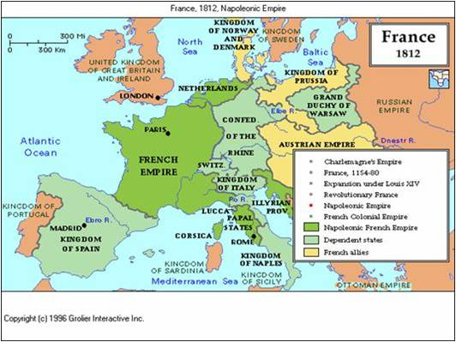
Annexed - To incorporate (territory) into an existing political unit such as a country, state, county, or city
Napoleon forcefully annexed most of Europe into his Empire and the Map of Europe was redrawn

Slide 6
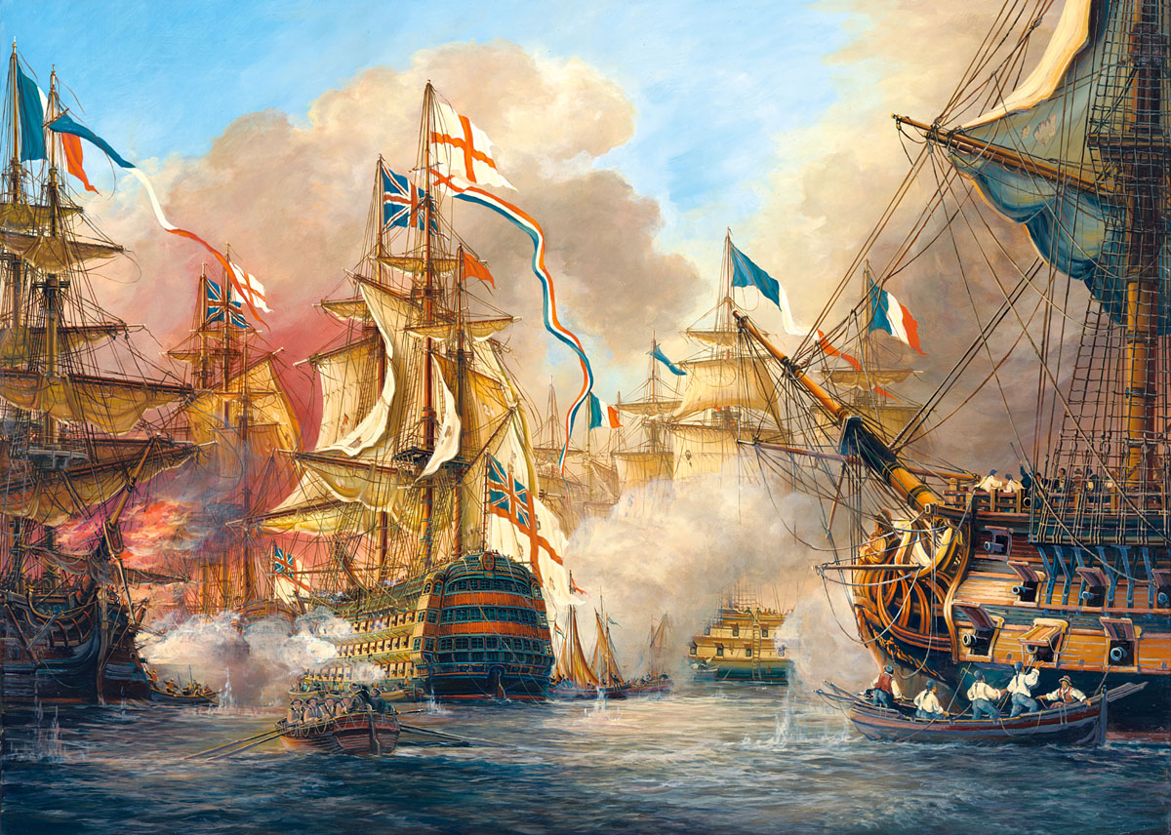
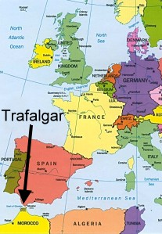
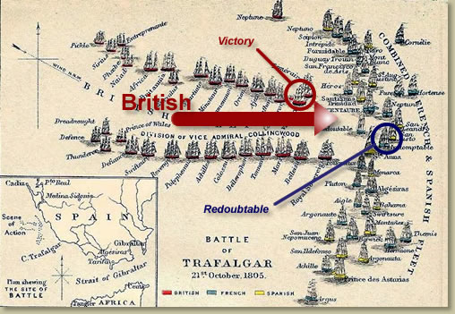
1805 he prepared to invade England - add it to Empire
The Battle of Trafalgar fought off southwest coast of Spain
Britain’s Admiral Horatio Nelson and the British Navy smashed the French Fleet

Slide 7
Blockade – Shutting off ports to keep people or supplies from moving in or out
Napoleon used Blockades to close European ports to the British
This economic warfare was called the Continental System - Napoleon figured if he couldn’t destroy them militarily at least he could economically.
However, Britain responded with its own blockade of European ports
Britain and France seized ships they suspected were bringing good to the other side.
British attacks on American ships sparked anger in the US and triggered the War of 1812

Slide 8
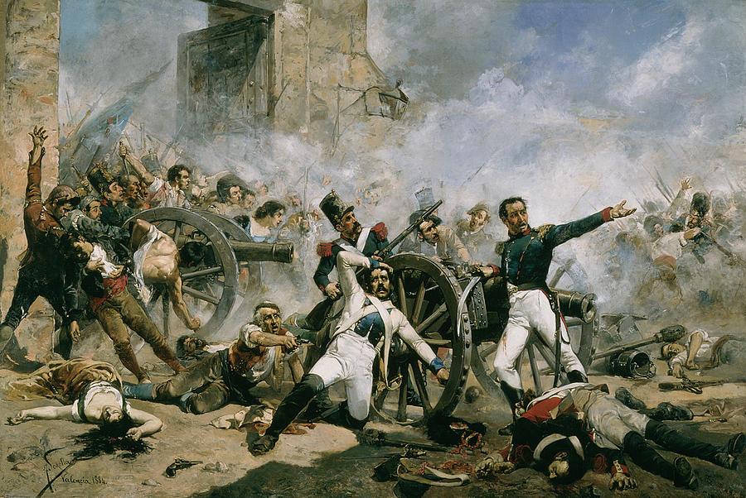
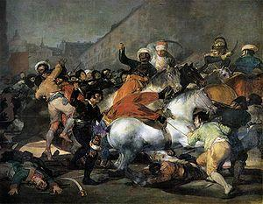
Nationalism works against Napoleon
Revolts against France spread all across Europe
Nationalist leaders encouraged loyalty for the mother nations and resented French foreign rule
Many Spaniards remained loyal to their King and devoted to the Catholic Church
Spanish patriots conducted a campaign of guerilla warfare, or hit-and-run raids against the French
These tactics kept French soldiers tied up that Napoleon needed elsewhere

Slide 9
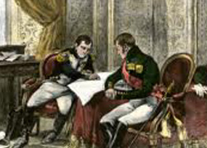
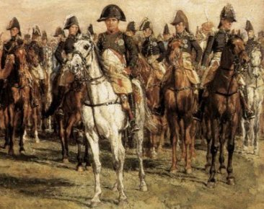
Russia was once an ally of Napoleon
The Tsar and Napoleon planned to divide Europe
Russia became unhappy with how things were working out -withdrew support
Napoleon turned on Russia – he assembled an army from 20 nations, The Grand Army, to invade Russia

Slide 10
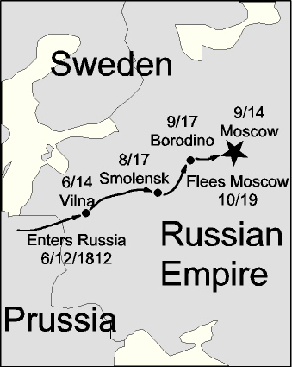
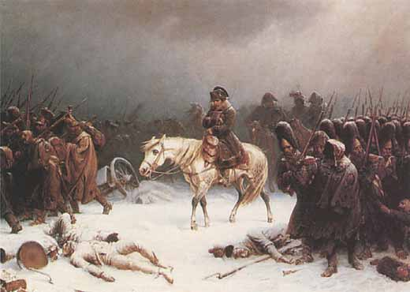
1812 – Napoleon, 600,000 soldiers & 50,000 horses invade Russia
Russians retreated eastward, burning crops and villages as they went – this is called scorched-earth policy – this left the French hungry and cold
No food, no shelter
Napoleon entered Moscow in September – realized he could not feed or supply his troops through the winter
In October, retreated to France
1,000 mile retreat: Russian attacks, brutal cold, starvation, death by exposure & disease
Less than 20,000 soldiers returned home!!!!
Napoleon’s reputation shattered!

Slide 11
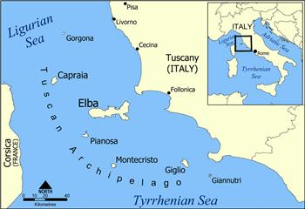
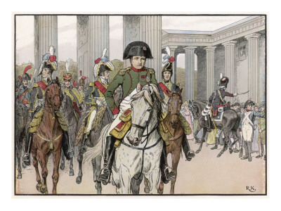
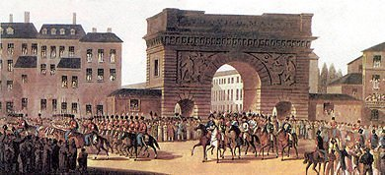
Abdicate – to step down from power
1814 – Napoleon abdicates and is exiled to Elba, an island in the Mediterranean
Louis XVIII, brother of Louis XVI of France is recognized as the new King of France
Many were afraid of things going back to the way things were before the Revolution
New support builds for Napoleon – he gathers an army and returns to France
Louis XVIII fled
March 1815 – Napoleon enters Paris in triumph

Slide 12
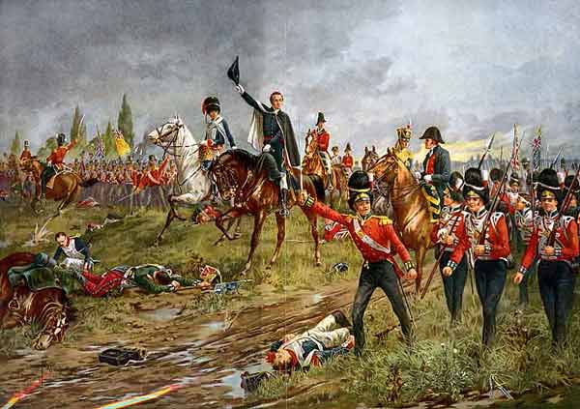
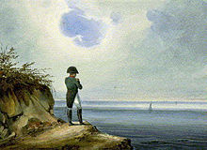
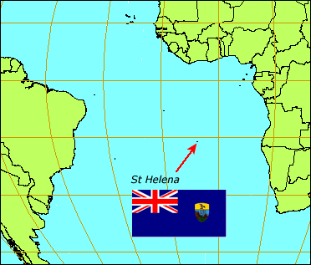
Napoleon’s victory was short lived
return to power lasted only 100 days
June 18, 1815 – opposing armies met near the town of Waterloo in Belgium
British forces under the Duke of Wellington
Prussian army commanded by General Blucher
France is crushed in an agonizing one day battle – The Battle of Waterloo
Napoleon again abdicates and goes into exile on St. Helena, an island in the South Atlantic – he would not return

